Slide 1


Slide 2
If I can, You certainly can
Count your blessings instead of your problems / limitations

Slide 3
Key to Success
Burning Desire
Attitude
Conceptual Clarity
Practice
(Some time) Lot of Patience and Faith
Best utilization of Article ship
Notes:
I thought in 2010 If my friends can , I can

Slide 4
My preparation
Identify mistakes committed
Rectified

Slide 5
Identify Mistakes
Selective Study
Over Reliance on tuition materials (Or only reliance)
Insufficient clarity on certain topics
Answer Writing defects
Attempted < 100 Marks
Attitude – Fear of failure, Lack of confidence

Slide 6
Rectification
100% coverage of syllabus ( “Especially day before exam” )***
1 Reference Book + Tuition Material + Practice Manual + RTP (MECE – Mckinsey Way)
Attempted Near to 100 or More marks
Attitude + Determined (Challenge to ICAI – but not publicly announced)

Slide 7
Attitude Management
Yoga
Veda Chanting
Reading some motivational books: My favourite is “Badukalu Kaliyiri”
Songs
Following Legends – AdiShankara, Swami Vivekananda, Abdul Kalam, Nani Palkiwalla,

Slide 8
Some regular questions to me from Students?
How did you concentrate? What’s Secret?
How many hours did you read?
How many months did you take exam leave?
Have you attended tuitions?
What did you read (like Materials)?

Slide 9
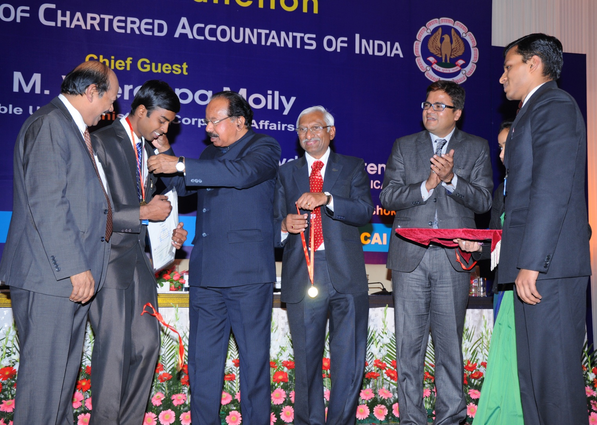
Results

Slide 10
Thank you
All the best for your exams

