Slide 1
The Future of the Profession
CA K.Raghu
Former President
The Institute of Chartered Accountants of India

Slide 2

CA- The Right Choice
Commands Respect in Society
A great career opportunity
Interesting and exciting work
The potential to work anywhere in the world.
Attractive pay packages
A secure profession
Demand for CAs is ever increasing
Develops Ethical values

Slide 3
Prospects for a Qualified CA
The Chartered Accountancy qualification opens the door to a vast range of exciting career opportunities, in every sector of business and finance, both in India and internationally.
Chartered Accountants are in constant demand both at home and abroad, being recognised for their technical competence, professional standards, and veracity.
Chartered Accountants occupy top positions in virtually every sector of the economy . The rewards that go with the CA qualification are significant.
Country | Population (Millions) | No. of CA, CPA | 1 CA per Population of | CA per 10,000 population
USA | 323 | 6,64,532 | 486 | 21
India | 1,324 | 2,80,221 | 4,725 | 2
UK | 66 | 1,43,190 | 458 | 22
Australia | 24 | 61,000 | 393 | 25
New Zealand | 5 | 33,000 | 142 | 70

Slide 4
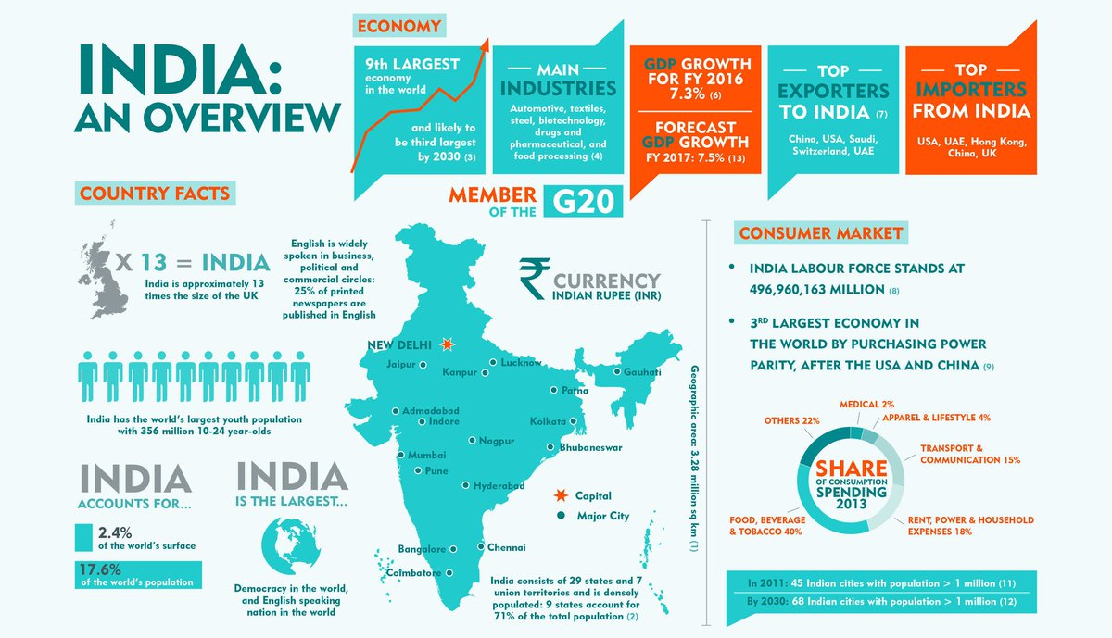

Slide 5
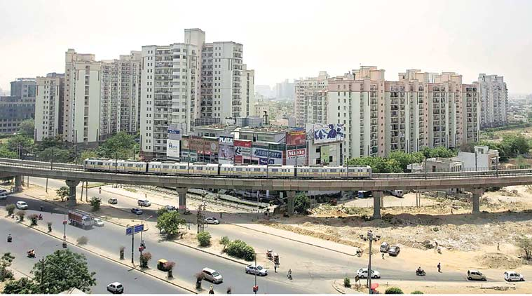
India is a happening country
Introduction of Goods and Services Tax
Demonetisation of Currency
Introduction of Swachh Dhan Abhiyan
Implementation of Indian Accounting Standards
Introduction of Standards on Internal Audit
Highest ever inflow of equity in the form of foreign direct investments.
Start-up hub for the world.

Slide 6
TEN QUALITIES TO BE SUCCESSFUL

Slide 7

1. Set your goals
S – Specific : Your goal must be clear and well defined.
M – Measurable : You should include precise dates in your goals so that you can measure your degree of success.
A – Attainable : Make sure that it's possible to achieve the goals you set.
R – Relevant : Goals should be in tune to the direction you want to take in your life.
T – Time Bound : Your goals must have a deadline.

Slide 8

2. Be Positive in Life
“A pessimist sees the difficulty in every opportunity; an optimist sees the opportunity in every difficulty.” ~Winston Churchill
Positivity is choosing to see the bright side of life. It is seeing the good in people.
Being positive is not about projecting a perfect life.
Rather, it’s about choosing to see the good in life, believing in the power of encouragement, and having hope that things will get better.

Slide 9

3. Be Good to Others
What goes around comes around - and with kindness it really does. Research shows that being kind to others increases our own levels of happiness as well as theirs.
It has a knock-on effect - kindness is contagious, so it makes our communities nicer places to be.
Being good to people we know, strengthens our connections with them and provides a source of support.
Being good to strangers helps build co-operation, trust and a sense of safety in our communities. It also helps us to see others more positively and empathise with them.

Slide 10

4. Uphold your Character
Uphold your dignity by walking away from people who only remember you when they want you.
Those with strength of character know the difference between right and wrong. They do what is right because it reinforces their commitment to personal excellence.
The person with a strong character is willing to upgrade his knowledge to become a better person.

Slide 11

5. Respect your Elders
Respect is when you feel admiration and deep regard for an individual.
You believe realise the good qualities and capabilities that they bring to your workplace.
You treat them with dignity and admire their qualities.
As such, you recognize that they have rights, opinions, wishes, experience, and competence.

Slide 12

6. Be Innovative
Idea Generation and Mobilization - Inspiration for a new idea can originate from an improvement of an existing idea, or something from scratch.
Advocacy and Screening - Advocacy and screening help evaluate an idea and measure its potential benefits and problems.
Experimentation - The experimentation stage tests an idea, such as with a prototype or pilot test.
Commercialization - This step makes the idea appealing to the audience.
Implementation - Implementation sets up everything needed to develop and utilize or produce the innovation.

Slide 13

7. Role Model to Emulate
High performers learn from other high performers. If you want to manifest a change in your life or achieve a certain goal, the best thing you can do is study people who have already done it.
You need to understand the qualities that makes your role model special, and decide which of those qualities you want to emulate.
Ask yourself how your life would be different if you emulated certain qualities of your role model.

Slide 14

8. Be Humble
Be Humble: Don’t let success go to your head
When you become successful, don’t rest on your laurels.
Don’t isolate yourself from people who hurt your ego.
Find creative ways to share the credit and pull people up the ladder of success along with you.
Remember where you came from and what you’ve learned along the way.
Help others to progress in life.

Slide 15

9. Be Committed
Get your mindset right: In order to truly “go all out” and make unprecedented progress, you must be committed.
Refine your goals: Nail down exactly what you want, how you are going to get there and on what sort of timeline you plan to reach your destination.
Focus on what’s important: “Going for it” doesn’t mean quadrupling your work load. Work for the sake of work is not the goal.
Hold yourself accountable: In order to stay committed, you need to be accountable.

Slide 16
10. Chase your Dream

Slide 17
OPPORTUNITIES IN THE PROFESSION

Slide 18
CA PRACTICE- A REAL TEST OF LIFE
Good quality of patience with extra courage to practice is a basic mantra to decide for practice.
The qualification opens the opportunity to set up practice independently.
When a newly qualified chartered accountant enters into a CA practice, he usually opts for a family owned firm or he joins a running firm as a partner. He can also start a new firm either alone or with his friends.
A CA in practice can chose to specialize in new areas of the profession such as Fraud Detection, Forensic Audit, International Taxation etc.

Slide 19
CA SERVICE- A REAL PLEASURE OF LIFE
CAs in Industry gets attractive pay packages in all verticals. There is a huge demand for CAs in traditional sectors as well as new-gen sectors.
A large number of newly qualified chartered accountants are recruited every year through campus interview by public sector, private sector, multinationals, banking and insurance companies.
Career progression is possible depending on the individual aspirations and abilities. CAs can become Chief Financial Officer of a major company within 10 to 15 years of qualification.

Slide 20
GLOBAL OPPORTUNITIES

Slide 21
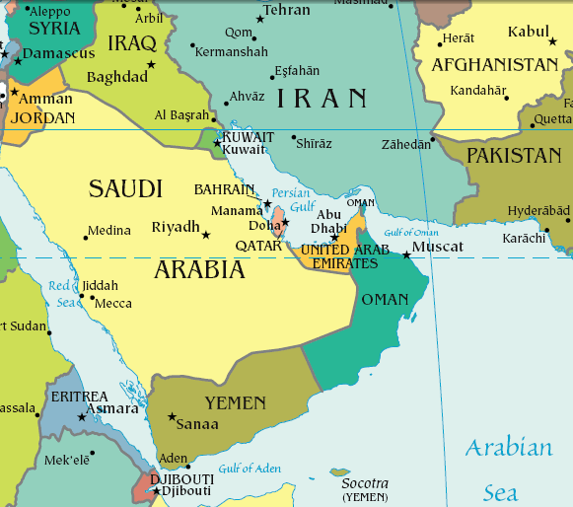
Gulf Region
Although their outbound destinations include different parts of the world, one of the most favourite destinations for CA’s is the Gulf region, comprising Bahrain, Kuwait, Oman, Qatar, Saudi Arabia and United Arab Emirates.
The resurgent Gulf region offers excellent growth opportunities to thousands of Indian Chartered Accountants who are extremely successful and they are highly respected for their commitment and hardworking attitude.
Today, more than 20,000 CAs work in the Gulf region and are offered attractive pay packages.
The new tax regime of UAE VAT from 01-01-17 has increased the opportunities for CAs.

Slide 22
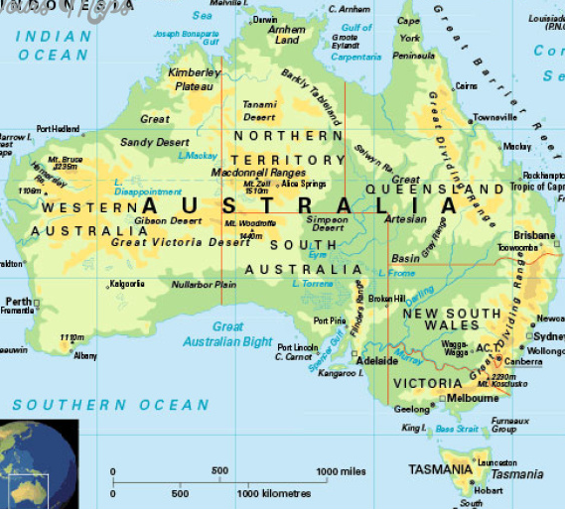
Australia
Currently, the Indian CAs have excellent career opportunities in Sydney, Melbourne, Brisbane, Perth, Adelaide and Canberra.
ICAI has signed Mutual Recognition Agreements- MRA’s with the Institute of Chartered Accountants in Australia (ICAA) and with Certified Practicing Accountants (CPA) Australia so that the Indian CA is recognised in Australia through principles of reciprocity.
Australia attracts a lot of Indian CAs because of excellent pay packages in the Banking, Pension and Insurance sectors.

Slide 23
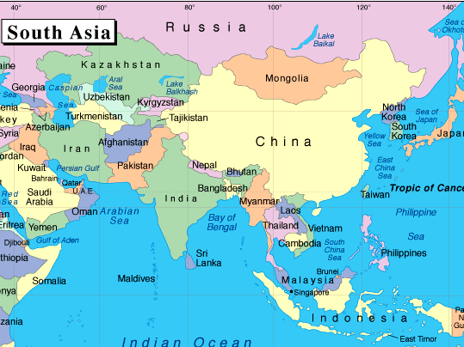
SAARC Countries
Indian CAs have a strong presence in the SAARC Region and we find that many Indian CAs working in Nepal, Bangladesh, Pakistan, Sri Lanka and Bhutan are highly successful.
ICAI closely works with the-
  Institute of Chartered Accountants of Nepal (ICAN)
  Institute of Chartered Accountants of Pakistan (ICAP)
  Institute of Chartered Accountants of Bangladesh and
  Institute of Chartered Accountants of Sri Lanka
and has initiated discussions with them for MoUs on knowledge sharing and mutual recognitions.

Slide 24
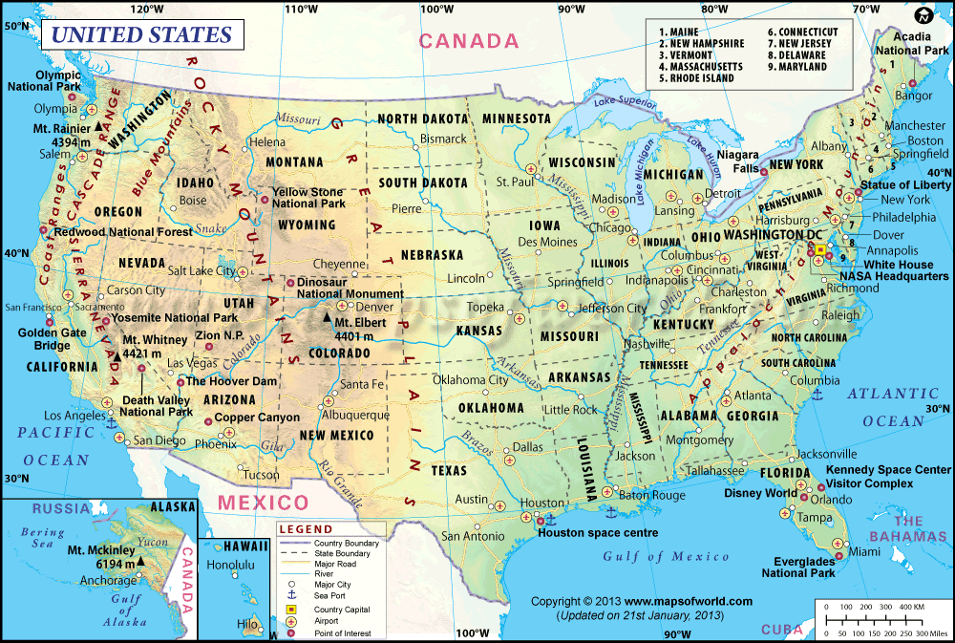
United States of America
America is another favourite destination for Indian CAs.
ICAI is working towards working with AICPA – The American Institute of Certified Public Accountants which is the largest accounting body of the world, for mutual recognition.
Indian CAs provide various consultancy services like tax advice, accounting services and assistance in Mergers & Acquisitions.

Slide 25
THE WAY FORWARD – THE FUTURE OF THE PROFESSION

Slide 26
How Technology Affects Us

Slide 27
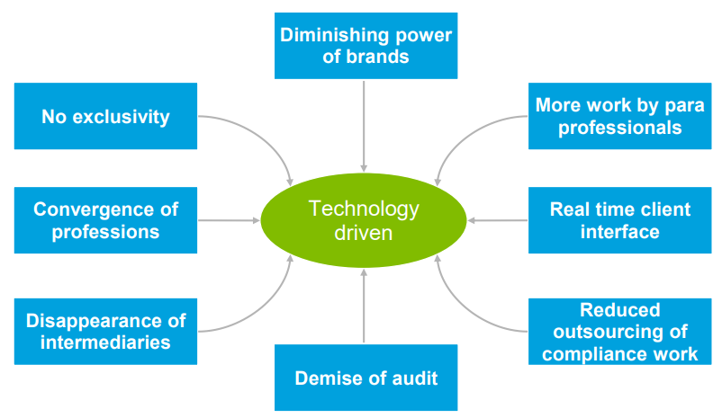
Impact of Disruptional and Transformational changes

Slide 28
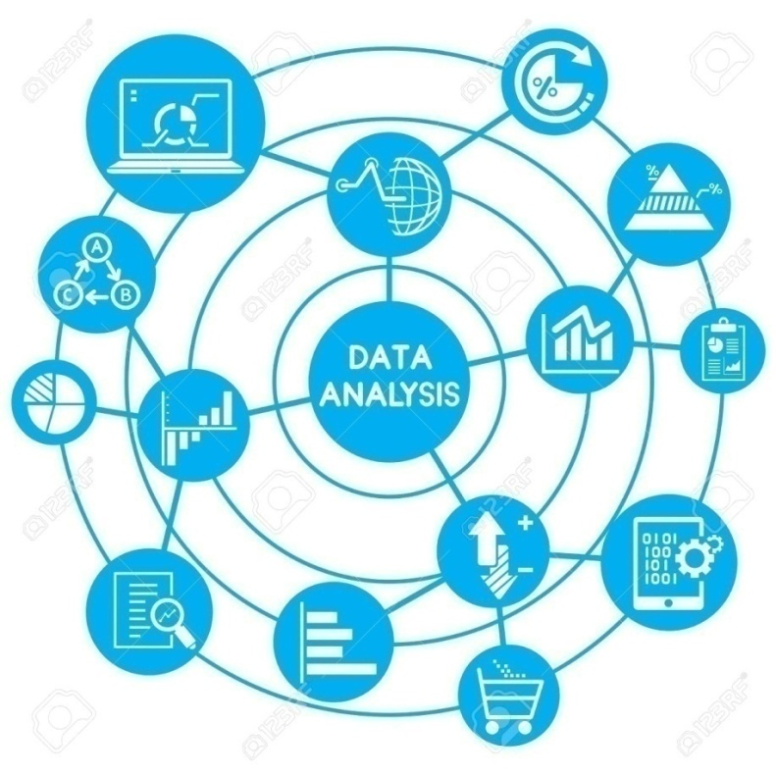

New Opportunities
Cloud Accounting: Storing accounting data on remote servers – making geography unimportant
Big Data and Analytics: Challenges like analysis, capture, search, sharing, storage, transfer, visualization, and information privacy could be resolved by use of Big Data Analytics.

Slide 29

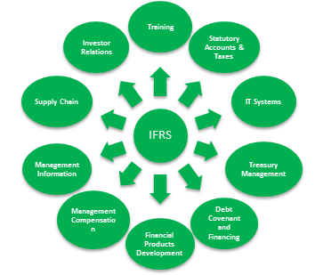
New Opportunities
IFRS Implementation: Need for a uniform financial reporting system has been felt for preparing comparable and globally understandable financial statements.
Technology Consulting: Cyber Risk Services which includes Cyber Strategy & Management, Cyber Intelligence and Cyber Analytics gaining ground due to advent of Mobile Technology, Cloud Computing and Social Media.

Slide 30


New Opportunities
Artificial Business Intelligence: Modulation and Synchronization of Data into useful, simple, accurate real-time narratives and reports.
Block Chain: An open, distributed ledger that can record transactions between two parties efficiently and in a verifiable and permanent way.

Slide 31


New Opportunities
FinTech: FinTech is the use of technology to support or enable financial services. It has impacted a wide array of sectors, including lending, personal finance, consumer banking and small business tools.
E-Commerce: The buying and selling of goods and services, or the transmitting of funds or data, over an electronic network, primarily the internet.

Slide 32
Way forward for the Profession looks exciting
Our profession has a great future inspite of changes and challenges.
Public at large and the Regulators are demanding more transparency.
Financial and Non-Financial information is considered a social good.
Companies require our profession to increase trust in the financials and the business
Regulation and decision making process are getting complex.
Growing Business Environment has put up an urgent need of independent and qualified professionals

Slide 33
Exciting future for the profession
Adapt to changes and ease the Challenges that our clients are facing
Make the profession attractive for talented and young people
Integrate technology into our day-to-day work
Innovative in attending to clients demands
Keep an open mind to different cultures and professions
The Way forward for the profession looks exciting

Slide 34
Thank you
CA K.Raghu
cakraghu@kraghu.com

