Slide 1







Changes in
Income tax Laws
CA. K Kaushik Raj
Union Budget 2018

Slide 2
Rates of Income-tax
Widening and deepening of tax base
Measures for promoting equity
Tax incentives
Facilitating insolvency resolution
Improving effectiveness of tax administration
Rationalization Measures
Miscellaneous
Focus Areas of Direct tax Proposals

Slide 3
Budget Highlights
Senior Citizens
Interest Income – move from 10K to 50K;
Hike in deduction in 80D - 30K to 50K;
Hike in deduction in 80DDB - 60K/80K to 100K;
Vaya Vandana Yojana – Invest limit doubled Rs.15 lacs;
Runway to New Employment Opportunities
For 3 years 8.33% employee share of PF will be borne by government for new employee;
Women Empowerment
Reduction Employees’ Contribution of PF from 12% to 8%
Increase in maternity leave from 12 to 26 weeks;
Ease of Doing Business – Companies
Transfer of immovable property by Holding to 100% Indian Subsidiary and vice versa exempt;
Tax rate 25% on profits for T/O up to Rs.250 crores;
For 3 years 12% employee share of PF will be borne by government for new employee in textile, leather and footwear industry;

Slide 4
Benefits To Senior Citizens
Paradigm Shift
No TDS up to 50K – 194A
Hike in deduction in 80D - 30K to 50K
Interest Income on Deposits up to 50K – 80TTB
Hike in deduction in 80DDB - 60K/80K to 100K
MEASURES FOR PROMOTING EQUITY
Notes:
Interest income 50K deduction eligible – only deposit opened in capacity of individual and not in capacity of Firm ,AOP or BOI
80 TTA excluded Senior. A specific section has been allotted to Senior Citizens 80TTB
“Baadae Logo Kae Liyae Baadae Exemptions”

Slide 5
Rates of Income-tax
Individuals
Less than
2,50,000
@ Nil
Between
2.5 lacs to 5 lacs
@ 5%
Between
5 lacs to 10 lacs
@ 20%
Above 10 lacs
@ 30%
Senior
Citizens
Between
3 lacs to 5 lacs
@ 5%
Between
5 lacs to 10 lacs
@ 20%
Less than
3,00,000
Above 10 lacs
@ 30%
Very Senior
Citizens
Between
5 lacs to 10 lacs
@ 20%
Above 10 lacs
@ 30%
Less than 5,00,000
Health and
Education Cess on Income-tax @ 4%
Corporate Tax Rate @ 25% for less than T/O Rs.250 crore in FY 2016-17
RATES OF INCOME-TAX
Notes:
Individuals – Surcharge @ 10% Total income more than 50lacs and 15% if more than 1 crore
Lower corporate tax rate will prevent from hiving of business.
What happens to the company incorporated after FY 2016-17?

Slide 6
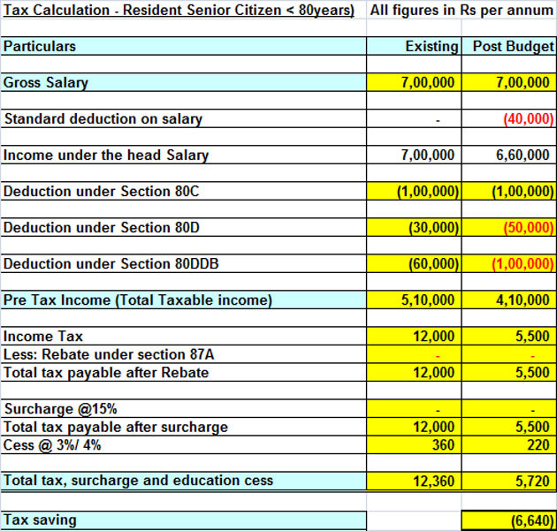
Rates of Income-tax
RATES OF INCOME-TAX
Notes:
Individuals – Surcharge @ 10% Total income more than 50lacs and 15% if more than 1 crore
Lower corporate tax rate will prevent from hiving of business.
What happens to the company incorporated after FY 2016-17?

Slide 7
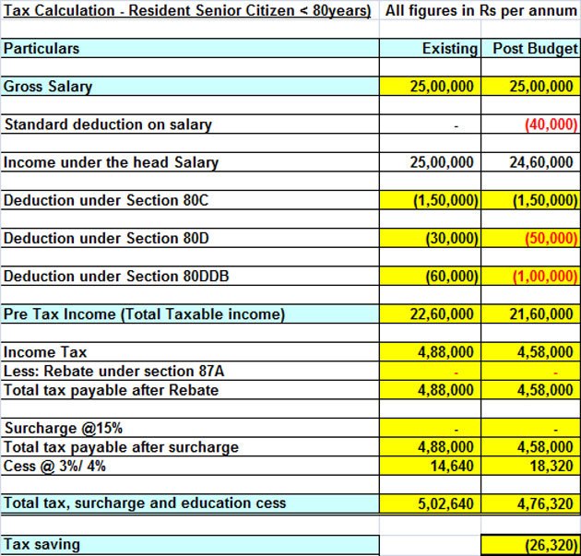
Rates of Income-tax
RATES OF INCOME-TAX
Notes:
Individuals – Surcharge @ 10% Total income more than 50lacs and 15% if more than 1 crore
Lower corporate tax rate will prevent from hiving of business.
What happens to the company incorporated after FY 2016-17?

Slide 8
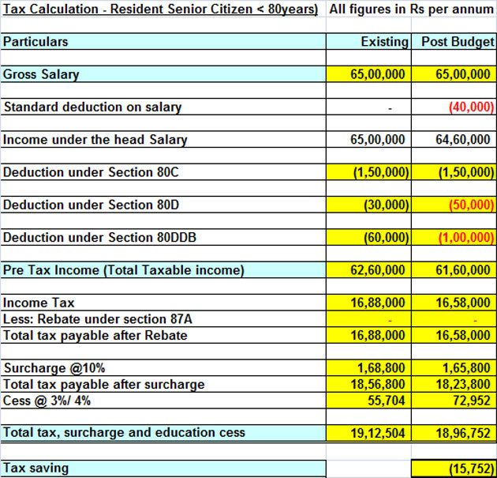
Rates of Income-tax
RATES OF INCOME-TAX
Notes:
Individuals – Surcharge @ 10% Total income more than 50lacs and 15% if more than 1 crore
Lower corporate tax rate will prevent from hiving of business.
What happens to the company incorporated after FY 2016-17?

Slide 9
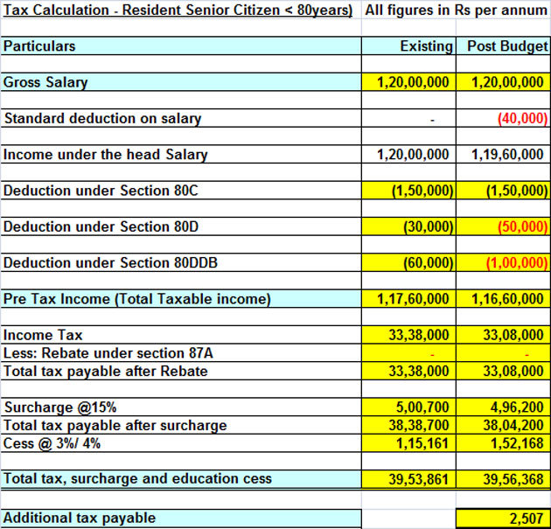
Rates of Income-tax
RATES OF INCOME-TAX
Notes:
Individuals – Surcharge @ 10% Total income more than 50lacs and 15% if more than 1 crore
Lower corporate tax rate will prevent from hiving of business.
What happens to the company incorporated after FY 2016-17?

Slide 10
Amendment of 115O & 115Q
Deemed dividend brought under the ambit of DDT
Dividend Rate @ 30% without grossing up
Non compliance of section 115-O shall constitute the company and its principal officers as assessee in default by virtue of section 115-Q
WIDENING AND DEEPENING OF TAX BASE
Notes:
Since, DDT is brought into 115-O ambit. Dividend received U/s 2(22)(e) will be exempted U/s 10(34).
Surcharge of 12% applicable on DDT – Applicability AY 2019-20

Slide 11
Sale of Equity Shares
Long Term Capital Gains taxable U/s 112A @ 10%
Benefit of Indexation not available
Sec 115AD: Non-Resident Gain Status : Exempt → Taxable @ 10%
Sec 10(38): No exemption for Long Term Equity Gains
Long term capital loss on sale of equity can be claimed.
WIDENING AND DEEPENING OF TAX BASE
Notes:
Withdrawal of Sec 10(38) for transfers made from 1st April, 2018
No LTCG exempt – Equity shares of a company, Equity Oriented Funds, Business Trust Units

Slide 12
Taxation of Gains on Sale of Equity Shares
Acquired Prior to 01.02.2018
Cost of Acquisition = Higher of A & B
A= Actual Cost
B= Lower of (i) and (ii)
(i) = FMV
(ii) = Sale Consideration
WIDENING AND DEEPENING OF TAX BASE
Notes:
Example in next slide

Slide 13
Taxation of Gains on Sale of Equity Shares
(INR lakhs)
All Amounts in INR | Scenario 1 | Scenario 2 | Scenario 3 | Scenario 4
Sale Consideration | 250 | 150 | 250 | 50
Cost of Acquisition | 200 | 150 | 100 | 100
Higher of A & B
A – Actual Cost | 100 | 100 | 100 | 100
B (Lower of i & ii) | 200 | 150 | 50 | 50
i – FMV | 200 | 200 | 50 | 200
ii – Sale Consideration | 250 | 150 | 150 | 50
Capital Gain/ (loss) | 50 | - | 150 | (50)
If only FMV is considered |  | (50) | 200 | (150)
WIDENING AND DEEPENING OF TAX BASE

Slide 14

Taxation of Gains on Sale of Equity Shares
Bonus Shares
Right Shares
Non STT Shares
WIDENING AND DEEPENING OF TAX BASE
Notes:
Bonus Shares: COA – 0 so lower of FMV or Sale Consideration will be considered as COA
Right Shares: CAO –Paid to acquire right, similar to normal sale of shares
Non-STT: Non-applicability of Sec 112A
Non-STT shares examples: Gifting of Listed equity Over The Counter and not through RSE
FMV means highest price on 31.01.2018 for listed and FMV for unlisted shares

Slide 15
Taxation of Gains on Sale of Equity Shares
Equity shares suffering heavy losses as at 31st March, 2018
Sharp increase in the share prices as at 31st March, 2018 compared to cost of acquisition
Available resorts for optimising the tax impact on gains from equity transactions
WIDENING AND DEEPENING OF TAX BASE
Notes:
Loss : then postpone the sale to FY 2018-19, since LTCL can be carry forwarded
Sharp Increase then sell as on 31.03.2018 and buy it as well since gain is exempt till 31.03.2018. – impact of buying and selling at the same time.
Resorts: Sec 54EE, all assesses can claim if gain is invested in the specified units as notified by CG
Sec 54F, Ind/HUF transfer any LTCA other than residential property and has invested consideration in one residential property

Slide 16
Non-Profit Organisations
Applicability of Sections 40 (a)(ia), 40 A(3) and 40 A(3A) to trusts registered U/s. 12AA.
Also applicable for entities registered for exemption U/s.10(23C).
An initiative for clean India.
WIDENING AND DEEPENING OF TAX BASE
Notes:
Tax audit – applicability and the impact on the report in Form 10B (Rule 17B) Section 12A
Section 43 – cost of fixed asset acquired in cash - not applicable to a trust
What happens to schools, hospitals operations in Trusts – whether the application of surplus is subject to 40 (a)(ia), 40 A(3) and 40 A(3A) of to the transactions incurred for arriving at the surplus itself.
These will lead to increase in the amount that needs to be spent by the trust for claiming benefit of Sec. 10(23C)
Disallowance will not be considered as Application of Income.

Slide 17
Section 16 & 17
Deduction Under Section 16;
Along with entertainment allowance and tax on employment;
A standard deduction of Rs.40K subject to salary accrued;
Applicable from 1st April 2019;
Removal of Rs.15,000/- benefit which was in the nature of medical expenditure and Rs.19,200 in the nature of conveyance allowance (not applicable to the differently abled).
MEASURES FOR PROMOTING EQUITY

Slide 18
Acceptable Variances In Consideration
New Proviso Is Inserted:
Variance of 5% is acceptable
Litigation for consideration on small variances will reduce
56(2)(x)(ii)
43CA
Assessed or assessable value – Value for Stamp Duty
105%
50C
Actual Consideration
100%
5% Acceptable Variance
RATIONALISATION MEASURES
Notes:
All this amendments will be applicable for the AY 2019-20
5% variance is on Consideration and is only applicable for immovable property

Slide 19
43CA-Mode of Consideration
Account Payee Cheque
Account Payee Bank Draft
Electronic Fund Transfer
Other Than Cash
RATIONALISATION MEASURES
Notes:
Consideration in modes of stock or any other asset is not possible consequent to the amendment.

Slide 20
Amendment to Section 54EC
Exemptions U/s 54EC
Only for land or building or both
Lock in Period 5 years
RATIONALISATION MEASURES
Notes:
If invested before 01.04.2018 then period 3 years lock in period
If invested after 31.03.2018 then 5 years lock in period
Now, gain arising on sale of long term cap gains on account of 112A securities cannot be invested in 54EC.
At present Series XI is running for REC Bonds with Tenor 36 months i.e., 3 years. As per Kumarpal Amrutlal Doshi Vs. DCIT (ITAT Mumbai), if cheque cleared after 6 months but issued within 6 months is eligible for 54EC exemption. Now, one can plan for investing in the 3 years bonds, if available, by issuing a cheque dated 31.03.2018 and clearing the same before 29.06.2018.

Slide 21
Amendment to Section 115BBE
Unexplained………..
Window to claim any expenditure or allowance against the income identified by the AO U/s 68, 69, 69A, 69B, 69C or 69D is no longer available from 01st of April, 2017.
RATIONALISATION MEASURES
Notes:
Efficiency of Draftsmen can be gazed. 1st April 2017 i.e., AY 2017-18 or FY 2016-17.
68 – Cash Credits
69 – Unexplained Investments
69A – Unexplained Money
69B – Investments undisclosed
69C – Unexplained Expenditure
69D – Hundi Borrowings

Slide 22
Amendment to 143
Adjustment in respect of addition due to difference in income appearing in Form 26AS or Form 16A or Form 16 and Return of Income is now relaxed while processing of return U/s.143(1)
IMPROVING EFFECTIVENESS OF TAX ADMINISTRATION
Notes:
Applicable from AY 2018-19

Slide 23
Amendment to Section 276CC
Non filing of Returns with 139(1)
Leads to penalty & prosecution
Tax payable is more than Rs.2,999/-
RATIONALISATION MEASURES
Notes:
Tax Payable will be determined after setting off the Advance tax and TDS Credit
Partnership firms with losses – non-filing of returns – whether 276CC is applicable?

Slide 24
PAN ‘n’ PAN
Obligation to obtain PAN
Non-individual entities + any persons competent to act on
their behalf
Financial transactions Value
Rs. 2,50,000 or more in a financial year.
WIDENING AND DEEPENING OF TAX BASE
Notes:
Earlier – Other than Individuals - Threshold limit for obtaining PAN was Basic Exemption Limit.
HUF – Impact on all members – only karta needs to have PAN – though there is no taxable income – it will force the HUF and karta to have a pan.
In case of business assessee’s = Limit: Turnover in excess of Rs.5,00,000/-

Slide 25
Stock-In-Trade to Capital Asset
Sec 28
Sale Value = FMV
Sec 2(24)
Income = FMV
Sec 49
Cost = FMV
Sec 2(42A)
Start Period = Conversion Date
Stock-In-Trade to Capital Assets
RATIONALISATION MEASURES
Notes:
Sec 28: FMV will be deemed to be the full value of consideration
Sec 49: For the purpose of computing Cap Gains, FMV on the date of conversion shall be the COA
2(42A): Period of holding start from date of conversion for the purpose of CG computation

Slide 26
New Employment Opportunities
Section 80JJAA
Erstwhile Provision: 30% Additional Benefit as Deduction for 3 Years
  Number of days employed is minimum 240 days or 150 days in respective assessment year
New Provision: 30% Additional Benefit as Deduction for 3 Years
  150 days benefit has been extended to footwear and leather industry
  240 days or 150 days criteria can be fulfilled in immediate succeeding year
TAX INCENTIVES
Notes:
Anomaly: Since, section will apply in subsequent year accordingly, if number of employees doesn’t increase then deduction under both the years will be lost.
Conditions:
Total Salary not more than 25K per month
PF Contribution not paid by Government
Employment = Less 240 days in a financial year
Not participating in a Recognised PF

Slide 27
Amendment to Section 80AC
Applicability of Section 80AC
Erstwhile
  80IA
  80IAB
  80IC
  80IB
  80IE
Current
  All the sections starting from 80HH to 80RRB covering 29 Sections.
RATIONALISATION MEASURES
Notes:
Income based Deductions Under Chapter VI A – part C only and not Part B (which is based on Payments)
Deductions under aforesaid sections are available only if the returns are filed under 139(1)

Slide 28
Amendment to Sec-80IAC
Period for Incorporation
1st April 2016 but on or before 1st April 2021.
Turnover
Does not exceed twenty-five crore rupees in any seven years from the year in which it was incorporated.
Exemption
100% of profit is deductible in three consecutive years out of 5 years from the year of incorporation.
Ambit of Eligible business has been widened.
Earlier business models driven by technology or intellectual property were eligible for deduction.
Now, all scalable business models with a high potential of employment generation or wealth creation can claim deductions.
TAX INCENTIVES
Notes:
Eligible start-up means a company or LLP engaged in eligible business which fulfils the following conditions, namely:--
it is incorporated on or after the 1st day of April, 2016 but before the 1st day of April, 2019;
the total turnover of its business does not exceed twenty-five crore rupees in any of the previous years beginning on or after the 1st day of April, 2016 and ending on the 31st day of March, 2021; and
it holds a certificate of eligible business from the Inter-Ministerial Board of Certification as notified in the Official Gazette by the Central Government;

Slide 29
Presumptive Income – 44AE
OLD PROVISON : No classification between heavy goods vehicle and other than heavy goods vehicle
NEW PROVISION
Heavy Goods Vehicle Rs. 1000 per ton X Gross Vehicle weight or Unladen weight X No. of Months For each Vehicle | Other Than Heavy Goods Vehicle Rs. 7500 X No. of Months For each Vehicle
WIDENING AND DEEPENING OF TAX BASE
Notes:
Gross Vehicle Weight or Unladen Weight – Anomaly
Goods Carriage =
Unladen Weight = Vehicle weight without goods
Gross Vehicle weight = Unladen Weight + Maximum capacity as certifies
Heavy Goods Vehicle means Gross vehicle weight exceeding 12000 kgs.

Slide 30
Section 9 – Business Connection
Erstwhile Provision
Habitually concludes contract on behalf of non-resident
New Provision
Who habitually plays a principal role leading to conclusion of contracts
WIDENING AND DEEPENING OF TAX BASE
Notes:
Role leading to conclusion of contracts are:
Contracts in the name of non-resident
For the transfer of the ownership of, or for the granting of the right to use, property owned by that non-resident or that non-resident has right to use; or
For the provision of services by the non-resident

Slide 31
Section 9 – Business Connection - SEP
Significant Economic Presence
Sustained Interaction
Aid of Technology
Other Automated tools
Through digital means
Systematic and continuous soliciting
Download of data or software in India
WIDENING AND DEEPENING OF TAX BASE
Notes:
(SEP) Significant Economic Presence
(i)any transaction in respect of any goods, services or property carried out by a non-resident in India including provision
of download of data or software in India if the aggregate of payments arising from such transaction or transactions during
the previous year exceeds the amount as may be prescribed; or
(ii) systematic and continuous soliciting of its business activities or engaging in interaction with such number of users as may
be prescribed, in India through digital means.

Slide 32
Amendments in Sec 56(2)(x)
Transfer of any asset between Subsidiary and Holding Company is exempt
Inclusion
Compensation in case of Termination/Modification of terms in case of employment. – Income from other sources
Exclusion
WIDENING AND DEEPENING OF TAX BASE
Notes:
47(iv)-Holding to 100% Indian Subsidiary Co.
47(v) – 100% Subsidiary to Indian Holding Co.

Slide 33
Amendment in Sec-10(12A)
Non-taxability of NPS income on closure has been extended to all individuals.
A move to provide benefits to all individuals.
Exemption benefit was earlier limited only to employed individuals.
RATIONALISATION MEASURES
Notes:
40% withdrawal from out of the contributions.

Slide 34
ICDS Impact on Act
ICDS
Deduction of M2M Losses
Revenue Policy on Construction Contracts
Valuation of Inventory
Impact on all Foreign Currency Transactions
RATIONALISATION MEASURES
Notes:
M2M – 36(1)(xviii) & 40A(13): M2M loss to be claimed as per ICDS others to be disallowed
Forex – 43AA all forex transaction gain / loss to be charged to P & L
Construction – 43CB : Contract definition & Percentage Completion as per ICDS-3
Inventory – 145A : Shares as C/S valuation as per ICDS – 8

Slide 35
Section 145B – Certain Incomes
Interest on enhanced compensation
Taxable on receipt basis
Taxation of Export Incentives or escalation of price
Based on reasonable certainty is achieved
Assistance by Central or State Govt. or any bodies
Taxable on receipt basis
RATIONALISATION MEASURES
Notes:
Taxation of escalation: Similar to ICDS IV: Revenue Recognition i.e., recognise when certainty is there.

Slide 36
Insolvency Resolution Process
Section 79
Section 140
Erstwhile Provision: Change In Share Holding Pattern Not More Than 51%
  Verification of returns in case of companies under insolvency can be now verified by Insolvency Professional
  On account of Death / gift to relative
  On account of amalgamation or demerger of 100% Indian Subsidiary of foreign company
New Provision: Relief Has Been Extended For Carrying Forward Of Losses
Section 115JB
  For company’s under insolvency resolution process, deduction allowed is aggregate of unabsorbed depreciation and brought forward losses
  Changes in share holding pattern due to insolvency proceedings and taken place as per approved resolution plan by Insolvency Board.
FACILITATING INSOLVENCY RESOLUTION
Notes:
Sec 79: applicable to companies where public are not substantially interested.
New Provision: Opportunity of being heard will be provided before the jurisdictional Principal Commissioner or Commissioner.
Both unabsorbed Depreciation and Loss to be aggregated and reduced to compute Book Profit – for Companies under insolvency.

Slide 37
Presumptive Income – 44B/BB/BBA/BBB
NEW PROVISON
Clarification provided about non-applicability of MAT provisions for the presumptive income
FACILITATING INSOLVENCY RESOLUTION
Notes:
Foreign companies and / or non-residents into
44B - shipping business
44BB - exploration of mineral oils
44BBA – operation of air crafts
44BBB – civil construction in turn key power projects

Slide 38
Insertion of New Clause in Sec-10
Royalty & FTS income of Non-Residents being amount received from National Technical Research Organisation is exempt.
An initiative for promoting transfer of technology.
Payments done by National Technical Research Organisation to Non-Residents will not trigger TDS U/s 195.
TAX INCENTIVES

Slide 39
Producer Companies
Initiative to promote agriculture activities in India.
Now, income earned by the Producer Companies is eligible for deduction.
Turnover Limit
T/O < Rs.100 Crores
Deduction Period
Beginning from AY 2019-20 and up to AY 2024-25.
Deduction
100% of Gains
TAX INCENTIVES
Notes:
In memo it was stated that benefit is for 5 years whereas in Finance bill we can find that 6 years benefit can be claimed.

Slide 40
Amendment to Section 271 FA
Penalty for failure to furnish statement of financial transaction or reportable account to the income-tax authority or such other authority or agency as may be prescribed shall be
Erstwhile
PENALTY
Current
Filed beyond the prescribed time U/s 285BA
Rs.100
Rs.500
Filed after expiry of time specified in notice
Rs. 500
Rs.1,000
MISCELLANEOUS
Notes:
AIR
Examples of Reportable Transactions:
Person subject to tax audit under section 44Ab – All cash receipts in excess of 2,00,000
Sub-registrar – transactions of immovable property

Slide 41
Amendment to Section 245-O
Erstwhile Provision
AAR for the purpose of Customs Act 1962 was AAR constituted under Section 245O
New Provision
Consequent to the new Customs Authority of Advance Ruling formed under Section 28EA of Customs Act 1962.
Impact
AAR under 245O shall now act as appellate authority for the purpose of Customs Act and cease to be as regular AAR
MISCELLANEOUS

Slide 42
Amendment in Section 286
Non-Resident parent of resident constituent entity needs to furnish CbCR.
For transparency and exchange of data, CbCR needs to be filed even if no specific agreements are entered for exchange of data.
RATIONALISATION MEASURES
Notes:
It is now proposed that a constituent entity resident in India, having a non-resident parent, shall also furnish CbCr in case its parent entity outside India has no obligation to file the CbCr in the latter’s country or territory.
It is now proposed that the due date for furnishing of CbCr by the alternate reporting entity of an international group, the parent entity of which is outside India, with the tax authority of the country or territory of which it is resident, will be the due date specified by its country or territory.

Slide 43
Amendment to Sec-286
FY 2017-18
CbCR
Reporting Timelines
31.03.2018
30.09.2018
30.11.2018
31.03.2019
Erstwhile Provision – Time Line till 139(1) due Date
RATIONALISATION MEASURES
New Provision – 12 months from the end of the FY
Notes:
It is now proposed that a constituent entity resident in India, having a non-resident parent, shall also furnish CbCr in case its parent entity outside India has no obligation to file the CbCr in the latter’s country or territory.
It is now proposed that the due date for furnishing of CbCr by the alternate reporting entity of an international group, the parent entity of which is outside India, with the tax authority of the country or territory of which it is resident, will be the due date specified by its country or territory.
If filed by constituent entity then due date in their country will be considered.

Slide 44
International Financial Services Centre
Section 47
Section 47
Regarded as not a transfer
-Capital Asset Bonds
-GDR
-Rupee Denominated Bonds
-Derivates
Transacted by Non Resident
+
Consideration is paid in Foreign Currency
In a Recognised Stock Exchange located in IFSC
Section 115JC and 115JF
“International Financial Services Centre”.
AMT rate shall be 9% instead of 18.5%.
Receives Income from convertible foreign Exchange
TAX INCENTIVES

Slide 45
Other Amendments - 1
Others
Agricultural Commodity Derivatives Not Speculative Transaction
Income – Employment Contracts
271J Order – Appealable - ITAT
Sec 193
7.75% Savings (Taxable) Bonds, 2018
MISCELLANEOUS
Notes:
Sec 43: Trading of Agricultural Commodity Derivatives is now treated as Non Speculative Transaction
Gains on account of termination or modification in business contracts will be covered under PGBP.
Sec 253: Order U/s 271J – Now Appealable before ITAT Penalty for furnishing incorrect information in reports or certificates by accountant
Sec 193: Any interest received on Govt issued Securities are not subject to TDS but excluded 8% bonds. Now, Govt. discontinued 8% bonds and started new bonds of 7.75%

Slide 46
Other Amendments - 2
Others
DDT @ 10% on EOF Dividend
Termination or Modification - Business Contracts - PGBP
Accumulated Profits – in amalgamation – For the purposes of dividend
Sec 115BA -25% is only for PGBP and circle rate applicable for all other income.
MISCELLANEOUS
Notes:
Sec 115R&T: Dividend pay-outs attracts 10% Dividend Distribution Tax on Equity Oriented Funds.
Sec 2(22): Amalgamating company’s profits to be considered in Amalgamated Company’s accumulated profit balance for dividend.
Sec 115BA: All sections under Chapter XII now shall not be subject to the rate of tax of 25%. They will be govern by the respective rates as specified in concerned sections.

Slide 47


Slide 48


