Slide 1
Examiner’s perspective CA chandraShekar

Slide 2
CHARTERED ACCOUNTANT

Slide 3
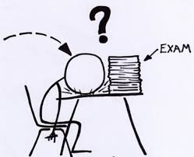

Slide 4
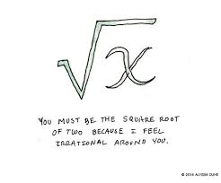
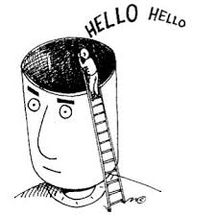
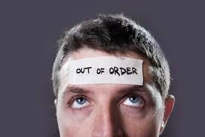
EXAM FEVER

Slide 5
Disappointments
Not able to complete the paper in full
Paper was tough
Tensed
Totally blank
Didn't give the exams this time
Costing paper was tough
Could have performed better
Under preparation
Fear – Pass or fail –
even before preparing

Slide 6
All our disappointments are a result and effect of not having enough appointment with ourselves.

Slide 7
Questions
When I was 4 years old my brother was half my age. Now, I’m 18 years. What ols is my brother?
Take 2 apples from 3 apples. How may do you have?

Slide 8
Questions
Some months have 30 days, some of them have 31 days, how many of them have 28 days?
I went to bed at 8 o’clock in the evening and woundup the clock and set the alarm to sound at 9 o’clock in the morning. How many hours sleep would I get before being woken by the alarm.
Take 2 apples from 3 apples. How may do you have?

Slide 9
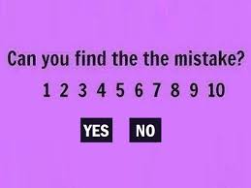

Slide 10
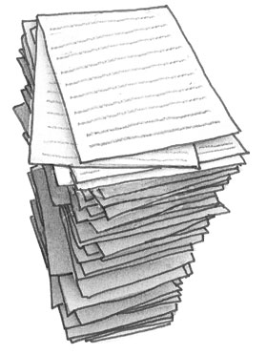
Examiner

Slide 11
Evaluation
Selection of Examiner’s
Process
Sample question papers
How sums are evaluated?
Stepwise marks

Slide 12
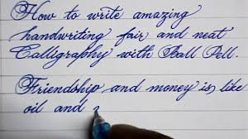
@ Beginning

Slide 13
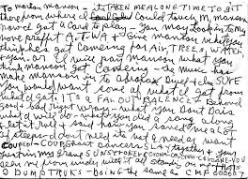
@ The End

Slide 14
Order of answering
Question numbers
1 (e)
5 (b)
2(a)
3(c )
4(d)
Irritates the examiner
Question numbers not written.

Slide 15
Marks V/s Answers
2 marks
Yes / No
No reasoning
I -2 pages is written
5 marks
Ideal answer ¾ to 1 page
Format of answer
Difference – charts, pie charts, flow charts

Slide 16
Presentation of answers
10 marks
3-4 pages with no break
Answer to be broken up
Facts
Section
Act/ rules
Body
Conclusion

Slide 17
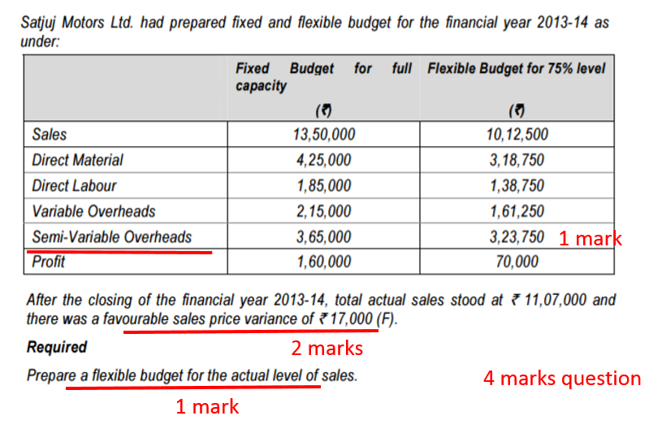

Slide 18
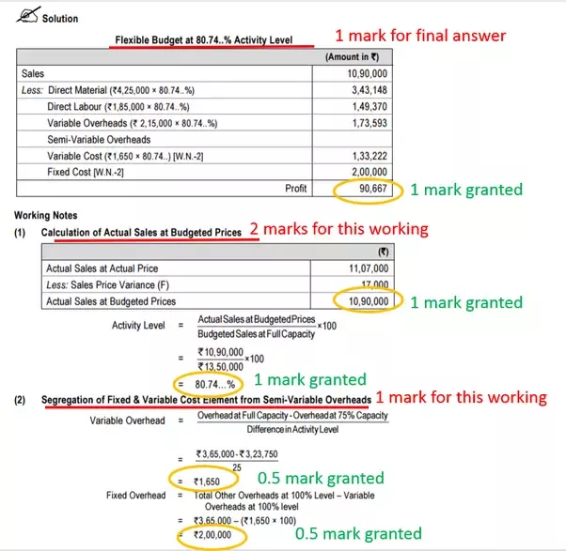

Slide 20
Theory v/s Practical
Bullet point
Precise
Points in line with examiners expectation
Simple Language
Specific Terminologies
Section Reference
Case law reference
Steps, Notes + Working
Neatly done
Avoid overwriting
Avoid mental calculations or back of answer paper
Conclusion
Assumptions

Slide 21
Lack of level of smart preparation
Handwriting
Beginning v/s End of paper
Language – English Grammar
Most of answers don’t have life in it
Answers are stereo type
Examiner-Valuation -15-20 minutes

Slide 22
Oral communication V/s Written communication
Oral communication
Written communication
Mode of Communication
One speaks and other hears
Clarification is possible
Actions
Language
Mode of communication
Written
No clarification is possible
Language - English /Hindi
Syncronisation
Mind
Hand
Pen

Slide 23
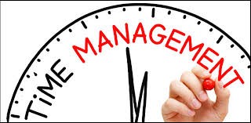
TIME
15 min revision
Attempt for 100 marks in 3hours (180 min)
Attempt entire paper
On an average 1.5 min for 1 mark to answer
2 marks - 3 minutes
5 marks – 7.5 minutes
10 marks – 15 minutes
20 marks – 30 minutes

Slide 24
U r responsibility
Impress upon the examiner
Reading has to be a Passion
Concentrate and
stay composed
Maintain u r Health
Group discussion
Handwriting
Planning
Systematic preparation
Introspection

Slide 25
"I am not afraid of a fighter who knows 1000 kicks,
but I am afraid of a fighter who has practiced
one kick 1000 times"

Slide 26
‘Illiterate of the 21st Century is not the one who does not know how to read and write but the one who does not change’
We should change and make the difference

Slide 27
Where to Change?
The way we prepare
Think out of the box
Change our attitude/perception about exams
How can my paper be outstanding i.e how can it be different from others
Change your approach

Slide 28
If not now then when
lets make a new beginning…………...

Slide 29
For any clarification
Shekar@ca-sny.com
Thank you

